Slide 1
Suffix Arrays
Michael T. Goodrich
University of California, Irvine
Includes slides adapted from slides by Carl Kingsford, Esko Ukkonen, and Haim Kaplan

Slide 7
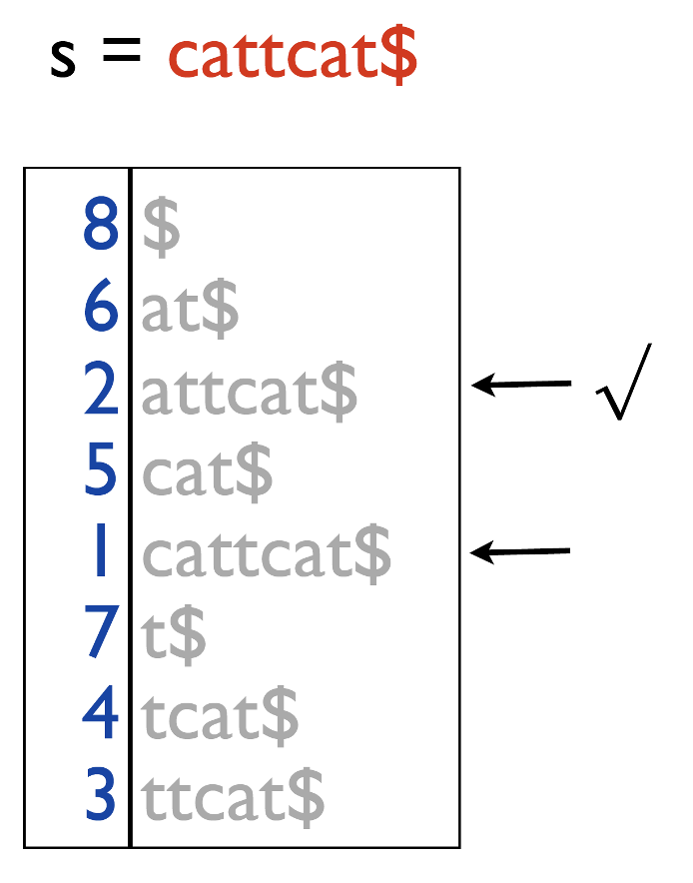
Simple Binary Search Time
Doing a simple binary search in a suffix array:
Each comparison takes O(n) time
Total time is O(n log n).*
We can speed this up with an auxiliary data structure…
* For a random string, this would be O(log² n) in expectation.

Slide 8
Example
Let S = mississippi
U
i
10
ippi
7
4
issippi
Let P = issa
1
ississippi
0
mississippi
M
9
pi
8
ppi
6
sippi
sisippi
3
ssippi
5
D
2
ssissippi

Slide 9
Lcp
Define Lcp(L,M) = length of the longest common prefix of the strings L and M.
LCP(issippi, ississippi) = 4
LCP(abacab, abacat) = 5
LCP(abacab, dogs) = 0

Slide 15
Computing these values by a naïve algorithm takes O(n²) time in worst-case and
O(n log n) expected time for random strings.

Slide 16
An O(n)-time algorithm
Key observation:
Let LCP[q]=h>1, i.e.,
S _{SA[q]} = t_{i}t_{i+1}…a_{i+h-1}t_{i+h}
S _{SA[q+1]}= t_{k}t_{k+1}…t_{k+h-1}t_{k+h}
= t_{i}t_{i+1}…t_{i+h-1}t_{i+h} ( t_{k+h}≠t_{i+h})
Then t_{i+1}…t_{i+h-1}=t_{k+1}…t_{k+h-1,}.
Define p S_{SA[p]} =t_{i+1}…t_{i+h-1}… therefore S_{SA[p+1]}=t_{i+1}…t_{i+h-1} …
i.e., LCP[p] ≥ h-1
When computing LCP[p] we can start the comparisons at position p+h-1.

Slide 17
The algorithm
for(i=0; i<n; i++) /* compute SA^{-1 */}
SA⁻¹[SA[i]] = i;
h = 0;
for(p=0; p<n; p++) {
if(SA⁻¹[p] > 0){
r = SA [SA⁻¹ [p]+1] ; while(T[r+h] = T[p+h])
h++;
LCP[SA⁻¹ [p]] = h;
if(h > 0)
h--;
}
}
innermost statement
Complexity:
Since h is decreased at most n times,
and h ≤ n,
h can be increased at most 2n times;
i.e., the innermost statement is executed ≤ 2n times.
Total time = O(n).

Slide 20
Constructing a Suffix Array from a Suffix Tree
Do a lexicographic depth-first search of the tree.
For every leaf, enter its index as the next entry in the suffix array.
O(n) time construction (also computes Lcp table).

Slide 21
Suffix tree vs suffix array
suffix tree ⬄ suffix array + LCP table
First step
S_{SA[0]}

Slide 22
Constructing a Suffix Tree from a Suffix Array
Step i
Which edge to split?
(Hint: consider using the Lcp table.)
Complexity:
The final trie has 2n vertices.
Each edge is traversed ≤ twice.
Time = O(n).
S_{SA[0]}
S _{SA[i]}
S_{SA[i-1]}

Slide 23
Constructing a Suffix Array Directly
We can construct a suffix array directly without already having a suffix tree.
Simple algorithm:
Sort the suffixes of the input string by any comparison-based algorithm
Each comparison takes O(n) time.
Total time: O(n) x O(n log n) = O(n² log n).
For a random string this would be expected to be O(n log² n).
We can get this down to O(n) worst-case time…

