Slide 1
Exact Matching Algorithms
Michael T. Goodrich
University of California, Irvine
Some slides adapted from https://www.cs.bgu.ac.il/~dinitz/Course/SS-12/Boyer-Moore-algorithm-Vladimir.pptx

Slide 2
Review: Strings
A string is a sequence of characters (indexed from 0)*
Examples of strings:
Python program
HTML document
DNA sequence
Digitized image
An alphabet Σ is the set of possible characters for a family of strings
Example of alphabets:
ASCII or Unicode
{0, 1}
{A, C, G, T}
Let P be a string of size m
A substring P[i : j] of P is the subsequence of P consisting of the characters with ranks between i and j
A prefix of P is a substring of the type P[0 : i]
A suffix of P is a substring of the type P[i : m − 1]
Given strings T (text) and P (pattern), the pattern matching problem consists of finding a substring of T equal to P
Applications:
Text editors
Search engines
Biological research
*Some people index starting from 1.

Slide 3
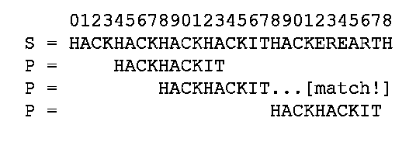
Application: fgrep
Recall that fgrep looks for an exact match of a text string in a file.
So we are interested in fast algorithms for the exact match problem:
Given a text string, T, of length n, and a pattern string, P, of length m, over an alphabet of size k, find the first (or all) places where a substring of T matches P.
Image from https://www.hackerearth.com/practice/notes/exact-string-matching-algorithms/

Slide 4
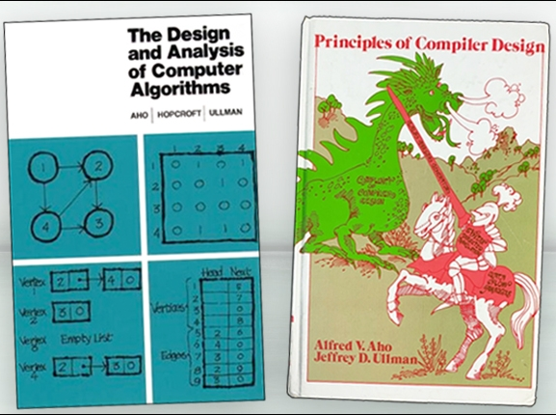
Alfred Aho
1975: Invented fgrep
…*
2020: received the Turing Award
* Also invented text processing techniques used in every modern source-code compiler and co-authored two influential textbooks.
Images from https://awards.acm.org/about/2020-turing

Slide 5
Brute-force Pattern Matching
Algorithm BruteForceMatch(T, P)
Input text T of size n and pattern P of size m
Output starting index of a substring of T equal to P or −1 if no such substring exists
for i ← 0 to n − m
{ test shift i of the pattern }
j ← 0
while j < m ∧ T[i + j] = P[j]
j ← j + 1
if j = m
return i {match at i}
else
break while loop {mismatch}
return -1 {no match anywhere}
The Brute-force (Naïve) pattern matching algorithm compares the pattern P with the text T for each possible shift of P relative to T, until either
a match is found, or
all placements of the pattern have been tried
Brute-force pattern matching runs in time O(nm)
Example of worst case:
T = aaa … ah
P = aaah
may occur in images and DNA sequences

Slide 6
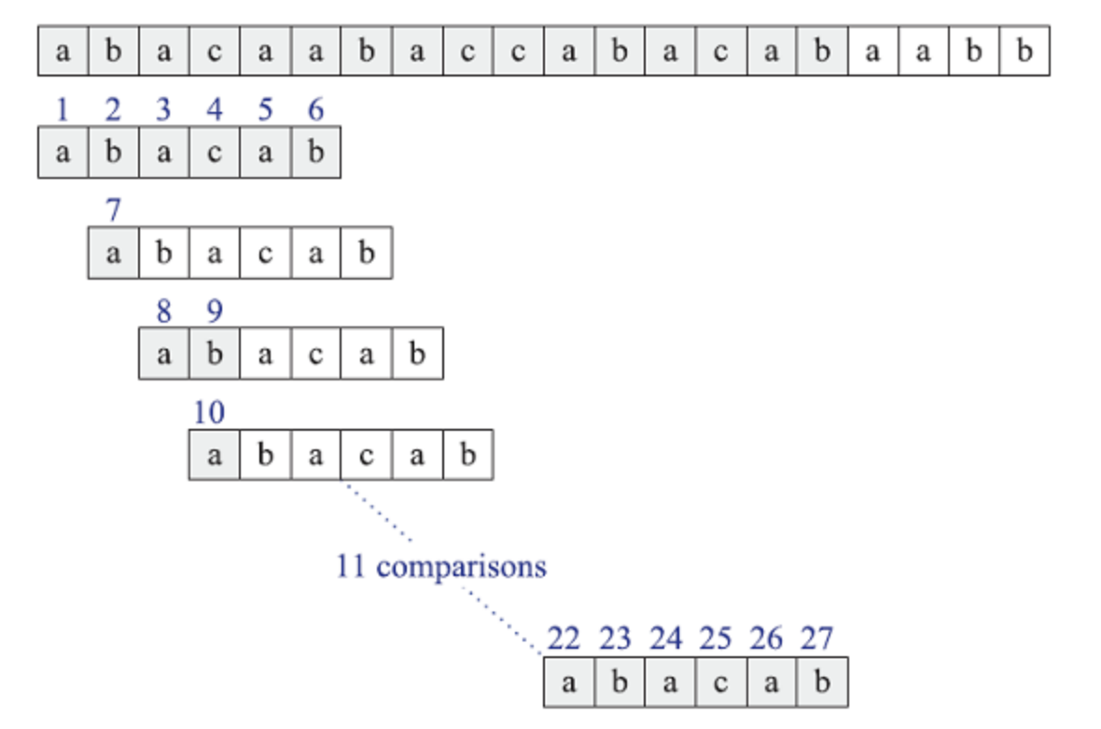
Brute-Force Matching Example
Trying every possible position for a match:

Slide 7
Expected-case Analysis for Brute-force
The worst-case running time for Brute-force algorithm O(mn), but it runs in expected linear time for random strings.
Suppose P and T are strings of m and n characters respectively chosen uniformly and independently at random from an alphabet of size k.
Let X_{i,j} be a random variable that is 1 if and only if P[i] is compared to T[j], and note that probability X_{i,j} is 1 is 1/k^{i} because this occurs when we have i character matches.
By the linearity of expectation, the expected number of comparisons for any T[j] is therefore
1/k + 1/k² + 1/k³ + … + 1/k^{m},
which is at most 2.
Thus, the expected number of comparisons is at most 2n.

Slide 8
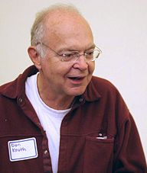
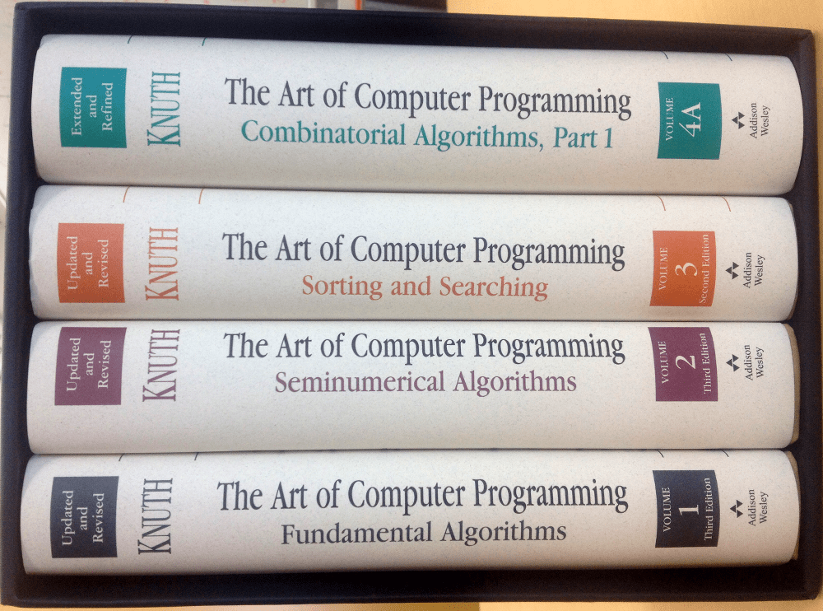
Donald Knuth
1973: Discovered the KMP algorithm (which was also published in a technical report by Morris and Pratt in 1970—all three published a joint paper describing the algorithm in 1977).
1974: Received the Turing Award.
He is also known for his book series, “The Art of Computer Programming,” which formalized and popularized algorithm analysis (e.g., the “big O”).
Image from https://en.wikipedia.org/wiki/Donald_Knuth

Slide 9
The KMP Algorithm
Consider the comparison of a pattern with a text as in the brute-force algorithm.
When a mismatch occurs, what is the most we can shift the pattern so as to avoid redundant comparisons?
Answer: the largest prefix of P[0..j] that is a suffix of P[1..j]
This approach is similar to the NFA-to-DFA approach, but is implemented more efficiently.
.
.
a
b
a
a
b
x
.
.
.
.
.
a
b
a
a
b
a
j
a
b
a
a
b
a
No need to
repeat these
comparisons
Resume
comparing
here

Slide 10
The KMP Failure Function
Knuth-Morris-Pratt’s algorithm preprocesses the pattern to find matches of prefixes of the pattern with the pattern itself
The failure function F(j) is defined as the length of the longest prefix of P[0..j] that is also a suffix of P[1..j]
Knuth-Morris-Pratt’s algorithm modifies the brute-force algorithm so that if a mismatch occurs at P[j] ≠ T[i] and j > 0, we set j ← F(j − 1)
j | 0 | 1 | 2 | 3 | 4 | 5
P[j] | a | b | a | a | b | a
F(j) | 0 | 0 | 1 | 1 | 2 | 3

Slide 11
The KMP Algorithm
The failure function can be represented by an array and can be computed in O(m) time
At each iteration of the while-loop, either
i increases by one, or
the shift amount i − j increases by at least one (observe that F(j − 1) < j)
Hence, there are no more than 2n iterations of the while-loop
Thus, KMP’s algorithm runs in optimal time O(m + n)
Algorithm KMPMatch(T, P)
F ← failureFunction(P)
i ← 0
j ← 0
while i < n
if T[i] = P[j]
if j = m − 1
return i − j { match }
else
i ← i + 1
j ← j + 1
else
if j > 0
j ← F[j − 1]
else
i ← i + 1
return −1 { no match }

Slide 12
Computing the Failure Function
The failure function can be represented by an array and can be computed in O(m) time
The construction is similar to the KMP algorithm itself
At each iteration of the while-loop, either
i increases by one, or
the shift amount i − j increases by at least one (observe that F(j − 1) < j)
Hence, there are no more than 2m iterations of the while-loop
Algorithm failureFunction(P)
F[0] ← 0
i ← 1
j ← 0
while i < m
if P[i] = P[j]
{we have matched j + 1 chars}
F[i] ← j + 1
i ← i + 1
j ← j + 1
else if j > 0 then
{use failure function to shift P}
j ← F[j − 1]
else
F[i] ← 0 { no match }
i ← i + 1

Slide 13
Example
j | 0 | 1 | 2 | 3 | 4 | 5
P[j] | a | b | a | c | a | b
F(j) | 0 | 0 | 1 | 0 | 1 | 2

Slide 14
The Boyer-Moore-Horspool Algorithm
The Boyer-Moore-Horspool algorithm for pattern matching a pattern P of length m in a text of length n is based on the following two simple heuristics:
Reverse-match heuristic: Compare P with a subsequence of T moving backwards
Bad-character heuristic: When a mismatch occurs at T[i] = c
If P contains c, shift P to align the last occurrence of c in P with T[i]
Else, shift P to align P[0] with T[i + 1]
Example:

Slide 15
Last-Occurrence Function
The Boyer-Moore-Horspool algorithm preprocesses the pattern P and the alphabet Σ to build the last-occurrence function L mapping Σ to integers, where L(c) is defined as
the largest index i such that P[i] = c or
−1 if no such index exists
Example:
Σ = {a, b, c, d}
P = abacab
The last-occurrence function can be represented by an array indexed by the numeric codes of the characters
The last-occurrence function can be computed in time O(m + k), where m is the size of P and k is the size of Σ. How?
c | a | b | c | d
L(c) | 4 | 5 | 3 | −1

Slide 16
The Boyer-Moore-Horspool Algorithm
Case 1: j ≤ 1 + l
Algorithm BoyerMooreHorspool(T, P, Σ)
L ← lastOccurenceFunction(P, Σ )
i ← m − 1
j ← m − 1
repeat
if T[i] = P[j]
if j = 0
return i { match at i }
else
i ← i − 1
j ← j − 1
else
{ bad-character-jump }
l ← L[T[i]]
i ← i + m – min(j, 1 + l)
j ← m − 1
until i > n − 1
return −1 { no match }
Case 2: 1 + l ≤ j

Slide 17
Example

Slide 18
Analysis
The Boyer-Moore-Horspool algorithm runs in O(nm + k) time in the worst case
Example of worst case:
T = aaa … a
P = baaa
The worst case may occur in images and DNA sequences but is unlikely in English text
The Boyer-Moore-Horspool algorithm can skip over some comparisons
It runs in O(n/m + m) time in the best case.

Slide 19
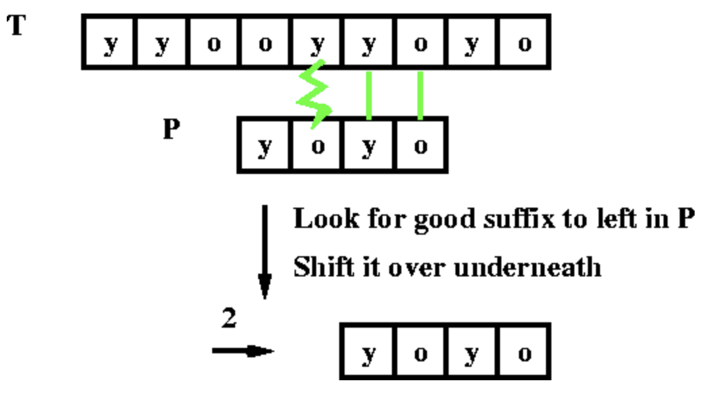
The Boyer-Moore Algorithm
The original Boyer-Moore has another heuristic, the good suffix rule:
When a mismatch occurs, we take the biggest shift possible using the bad character and good suffix rules
Image from https://eecs.wsu.edu/~cook/aa/lectures/l24/node16.html

Slide 20
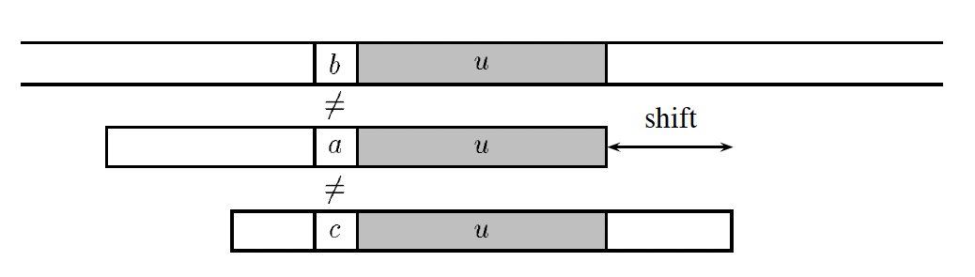
Case 1 for the good suffix rule
Suppose we have already matched a suffix, u, of P, and u appears in P. Then we want a shift that is guaranteed to match u and requires the mismatching character to be different:
T:
P:
P:
Image from https://doi.org/10.1016/S1570-8667(03)00005-4

Slide 21
Case 2 for the good suffix rule
Suppose we have already matched a suffix, u, of P, and u does not appear in P. Then we want a shift such that a prefix v is a suffix of u:
T:
P:
P:
Image from https://doi.org/10.1016/S1570-8667(03)00005-4

Slide 22
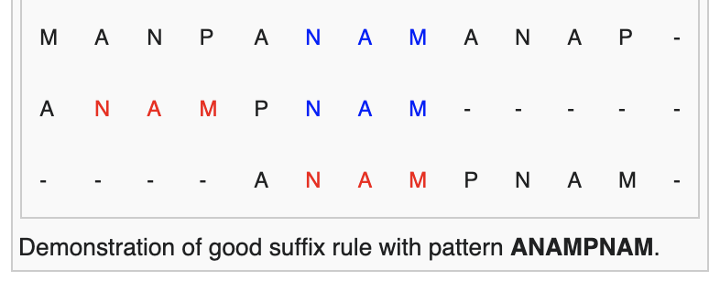
Good Suffix Rule
Definition: Suppose for a given alignment of $P$ and $T$, a substring $t$ of $T$ matches a suffix of $P$, but a mismatch occurs to the next character to the left. Then find, if exists, the rightmost copy $t′$ of $t$ in $P$, such as $t′$ is not a suffix of $P$ and the character to the left of t' in P differs from the character to the left of t in P. Shift $P$ to the right, so that substring $t′$ in $P$ is below substring $t$ in $T$.
Image from https://en.wikipedia.org/wiki/Boyer%E2%80%93Moore_string-search_algorithm

Slide 23
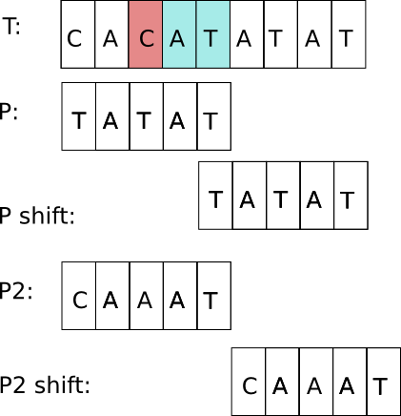
Good suffix rule (cont'd)
If $t′$ does not exist, then shift the left end of $P$ past the left end of $t$ in $T$ by the least amount, so that a prefix of $P$ matches a suffix of t in $T$. If no such shift is possible then shift $P$ by m places to the right.

Slide 24
The good suffix shift table
Define a shift table, MATCH(i), that encodes the good suffix shifts for a pattern, x, of length m.
MATCH(i) = min. s such that Cs(i,s) and Cos(i,s) hold:
Images from https://doi.org/10.1016/S1570-8667(03)00005-4

Slide 25
The bad character shift table
Let x be a pattern of length m.
Define a bad-character shift table, occ[a], for each character, a, in the alphabet for x:
This is just the last occurrence function, L, indexed slightly differently.
It can be computed in the same way as L.
Image from https://doi.org/10.1016/S1570-8667(03)00005-4

Slide 26
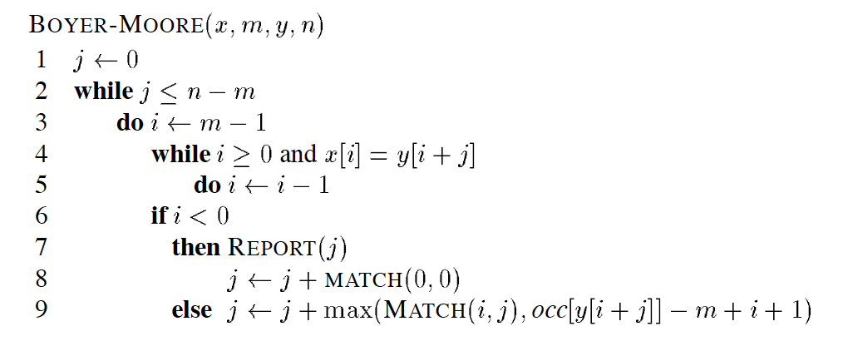
The Boyer-Moore Algorithm
Let x be a pattern of length m and y a text of length n.
j is the location of a possible match.
)
) ,
Algorithm description from https://doi.org/10.1016/S1570-8667(03)00005-4

Slide 27
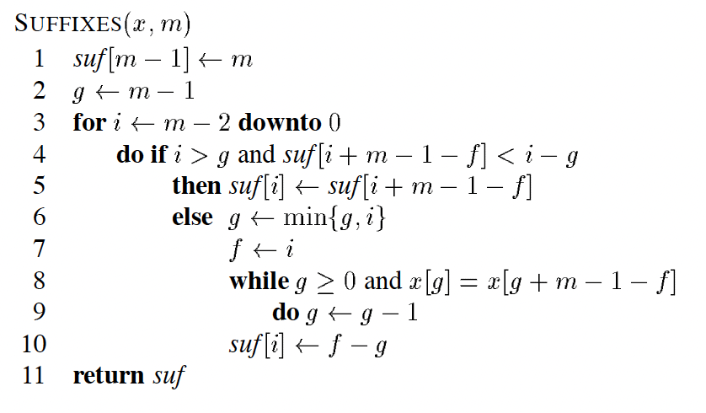
Computing the Suffix table
Compute a table, suf, such that suf[i] is the length of the longest suffix of x ending at position i in x.
We can compute the suf table like the KMP Failure function, but in reverse (j = g+m-1-f):
Algorithm description from https://doi.org/10.1016/S1570-8667(03)00005-4

Slide 28
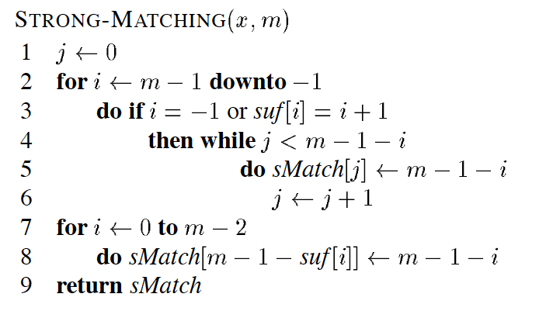
Computing the MATCH table
Given the suffix table, suf, we compute MATCH to be sMatch in the following algorithm:
Algorithm description from https://doi.org/10.1016/S1570-8667(03)00005-4

Slide 29
Summary for the Boyer-Moore Algorithm
The Boyer-Moore algorithm runs in O(n + m) time in the worst case.
It runs in O(n/m + m) time in the best case.
It can be further optimized to find all occurrences of a pattern in a text using at most 1.5n character comparisons.

Slide 30
Experimental Analysis
Since completely random strings are not useful for analyzing exact string-matching algorithms, we need alternatives:
Seeded random strings: Create a random text string, T, of length n (e.g., n=1,000,000), and a random pattern, P, of length m (e.g., m=5, 10, 20, …). Then insert P into T at 1 to100 random locations.
English text: Use a corpus of large English text (e.g., emails) and search for patterns of various lengths (e.g., email addresses, English words, English phrases).

Slide 31
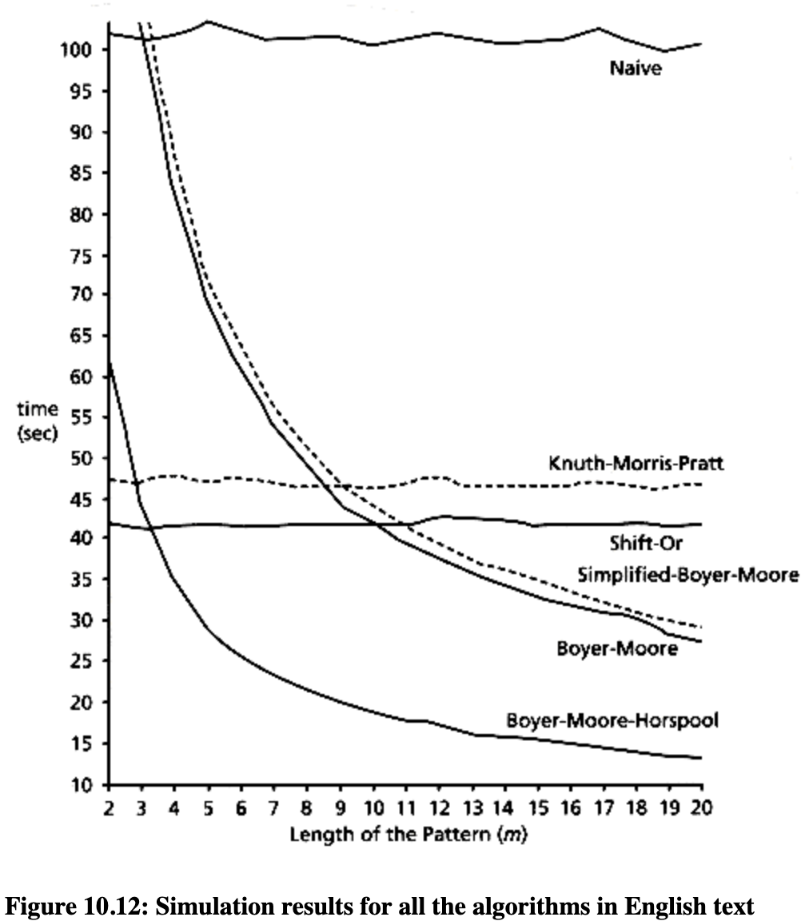
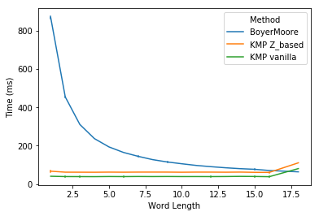
Varying the Pattern Length
One type of experiment: Keep the text size fixed at a reasonably large amount and vary the pattern size.
Images from https://dearxxj.github.io/post/4/, http://orion.lcg.ufrj.br/Dr.Dobbs/books/book5/chap10.htm

Slide 32
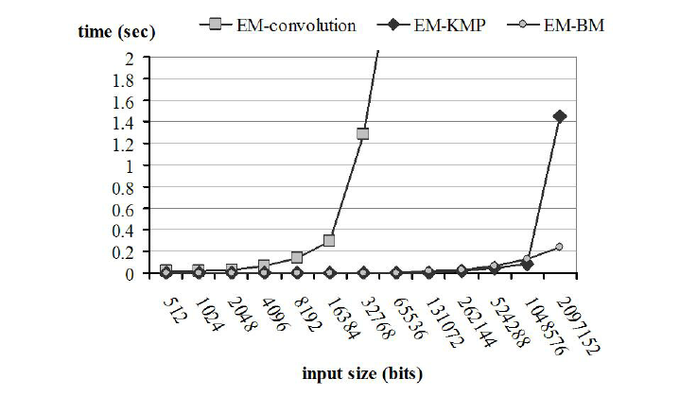
Varying the Text Length
Another type of experiment: Vary the text length, n, with certain pattern lengths (e.g., m=10, 20, 100) or as a function of n (e.g., m=n^{1/2} or m=n/8).
Image from https://www.researchgate.net/figure/A-comparison-of-the-convolution-KMP-and-Boyer-Moore-algorithms-for-the-exact-matching_fig2_220444712

Slide 33
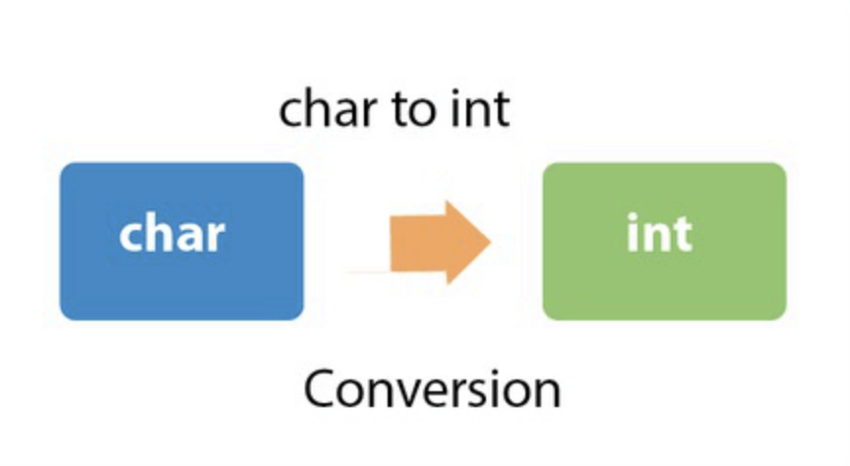
Data Type Duality
Rather than rely only on comparing characters, numerical matching algorithms take advantage of the fact that characters in a string can also be viewed as (binary) numbers.
This concept is referred to as data type duality.
Image from https://www.javatpoint.com/java-char-to-int

Slide 34
The Rabin-Karp Algorithm
The Rabin-Karp string searching algorithm calculates a hash value for the pattern, and for each M-character substring of text to be compared.
If the hash values are unequal, the algorithm will calculate the hash value for next M-character sequence.
If the hash values are equal, the algorithm will do a Brute Force comparison between the pattern and the M-character sequence at this location (in case of a hash value collision causing a false match).
In this way, there is only one comparison per text subsequence, and Brute Force is only needed when hash values match.
(Recall that we highlighted Michael Rabin in a previous lecture.)

Slide 35
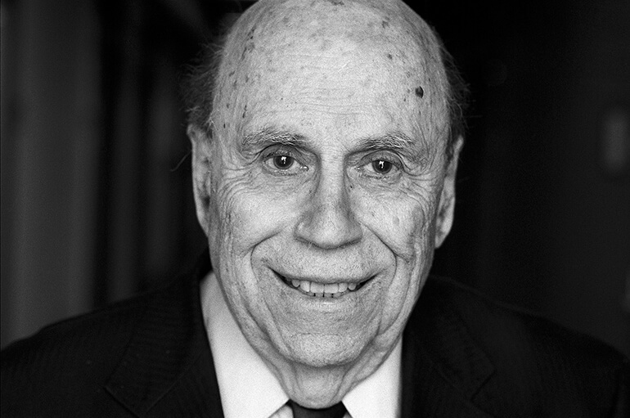
Michael Rabin
1959: Invented nondeterministic finite automata and introduced polynomial time as a notion of algorithm efficiency
1976: Received the Turing Award.
1987: Developed the Rabin-Karp string searching algorithm with Richard Karp.
Image from https://www.heidelberg-laureate-forum.org/laureate/michael-o-rabin/

Slide 36
Richard Karp
1985: Received the Turing Award.
1987: Developed the Rabin-Karp string searching algorithm with Michael Rabin.
He is also known for publishing a landmark paper proving 21 problems to be NP-complete.
The PhD advisor of UCI Professor Sandy Irani.
Image from https://en.wikipedia.org/wiki/Richard_M._Karp

Slide 37
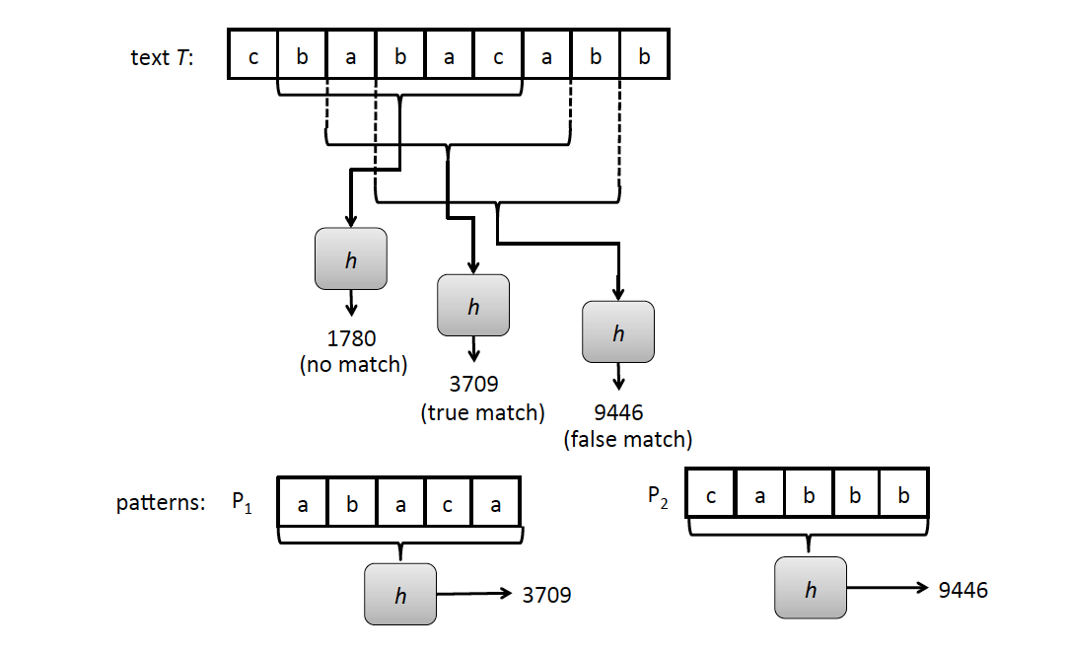
Rabin-Karp Example
Text T = cbabacabb
Pattern P = abaca

Slide 38
Rabin-Karp Algorithm (High Level)
text is n characters long, pattern is m characters long
hash_p=hash value of pattern
hash_t=hash value of first m letters in text
repeat
if (hash_p == hash_t)
do brute force comparison of pattern and selected section of text
hash_t = hash value of next section of text, one character over
until (end of text or brute force comparison == true)
Running time is O(nm) if we recompute hash_t for each substring of m characters in the text, which is no better than brute-force matching!

Slide 39
Rabin-Karp Rolling Hash Function
We can do better by using a rolling hash function, which allows us to compute each hash value from the previous hash value.
Consider an m-character sequence as an m-digit number in base b, where b is the number of letters in the alphabet. The text subsequence t[i : i+m-1] is mapped to the number
Given x(i) we can compute x(i+1) for the next substring t[i+1 : i+M] in constant time:

Slide 40
Polynomial Rolling Hash Function
The original Rabin-Karp algorithm used the a standard polynomial hash function:
This requires 2 multiplications and an addition and subtraction to compute each new hash value.
Multiplications are generally slower than comparing characters, and these multiplications are in the “inner loop” of the algorithm.
So it may be helpful to have a different hash function.

Slide 41
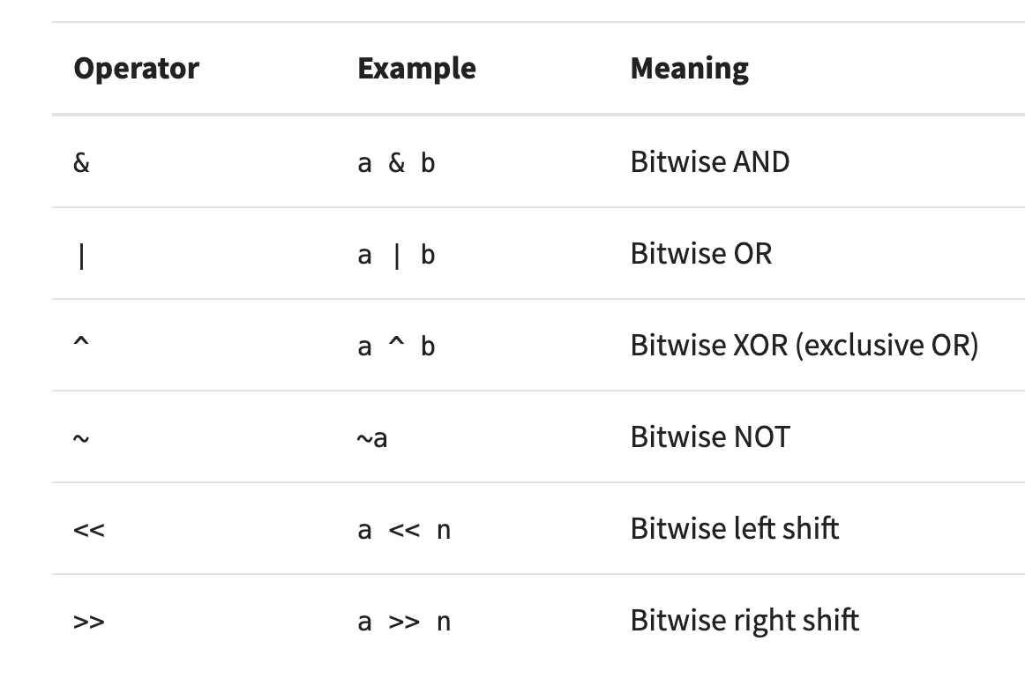
Bitwise Operators
Typical built-in bitwise (bit-parallel) operators, which are faster than multiplication:
Image from https://realpython.com/python-bitwise-operators/

Slide 42
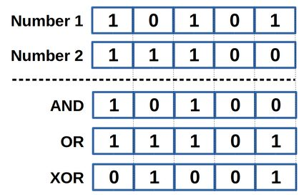
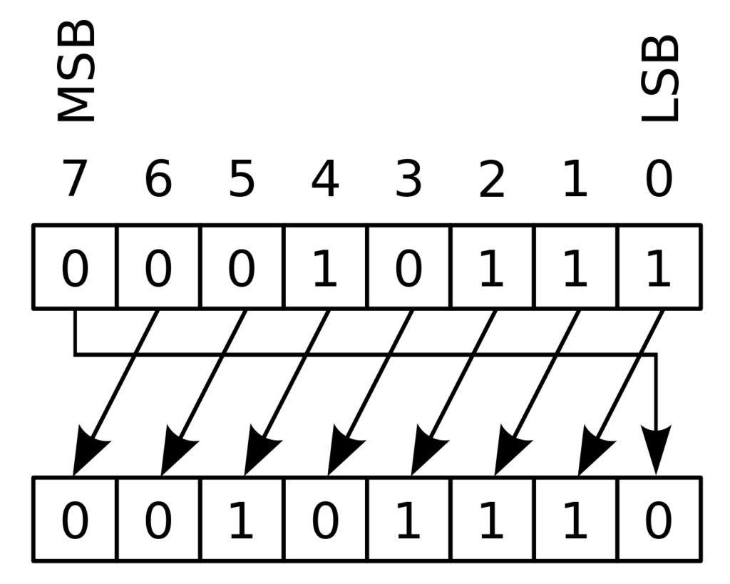
Examples
Bitwise operations:
Cyclic shift by 1 bit:
Note the following:
X AND X =X
X OR X = X
X XOR X = 0
Note that bit vectors are indexed
from right to left.

Slide 43
Typical Syntax for Cyclic Shift
To do a cyclic shift by k bits in C (assumes k < Integer.SIZE):
return (bits << k & MASK) | (bits >> (Integer.SIZE - k))
Cyclic shift by 1 bit:
MASK: 1 1 1 1 1 1 1 0

Slide 44
Cyclic Polynomial Hash Function
Let the function s be a cyclic binary rotation (or circular shift): it rotates the bits by 1 to the left, pushing the leftmost bit around to the first position.
E.g., s(101)=011, s(101)=011.
Define the hash H as follows, where ⊕ is XOR and h is a random hash function (or lookup table):
The new hash value (2 shifts and 2 XORs):

Slide 45
The Rabin-Karp Algorithm
Assumes a shiftHash(f, T, i) function for computing a shifted rolling hash value for position i in T given the hash value, f, for position i-1 in T.
Let H be the hash of the pattern, i.e., H = h(P)
for i ← 0 to n − m do
if i = 0 then // initial hash
f ← h(T[0 : m − 1])
else
f ← shiftHash(f, T, i)
if f == H then
// check P against T[i : i + m − 1]
j ← 0
while j < m and T[i + j] = Pk[j] do
j ← j + 1
if j = m then
return j as a match location

Slide 46
Analysis of the Rabin-Karp Algorithm
We are given a test of length n and a pattern of length m.
Use a hash function that is random enough so the probability of a false match is at most 1/m.
Then the expected running time to find a first match for the pattern (if it exists) is O(n+m).

