Slide 1
Introduction to Databases
CustomerID * Name Address Phone SSN
CustomerID AccountNumber
AccountNumber* TransactNumber Amount
Account Table
Transaction Table
Customers Table
* Denotes Primary Key
© 2013 by the Rector and Visitors of the University of Virginia.
This work is made available under the terms of the Creative Commons Attribution-ShareAlike 4.0
International license http://creativecommons.org/licenses/by-sa/4.0/

Slide 2
Some Vocabulary
Database – set of (related) tables
Table – set of rows and columns
Column – field, attribute
Row – Tuple, observation, case
DBMS – Database Management System

Slide 3
Spreadsheets vs. Database
Spreadsheets are best if:
Data can be stored in a single datasheet without lots of redundancy
You are doing simple calculations or making visualizations
Don’t need to link several spreadsheets together to get the results you want
Databases are best if:
You have a lot of data
Data are readily stored in multiple related tables
You need multiple user access
You want to be able to do complex manipulations with the data
You want to develop data entry tools
Notes:
Before we learn all about Relational Databases… let’s compare to Excel to a database….
And…..
Security – somebody getting in to the spreadsheet and making changes Databases can have username/password access. With MySQL database can be shared using multiple access points (software).

Slide 4
(Some of the) Problem with Spreadsheets
Data integrity
Internal record consistency is not maintained
Updating more than one record
Removing information
Creating incomplete cells/validating data
ID | DeptName | DeptAddress | ContactName | ContactTitle | ContactPhone
1 | Finance | 110 5th Street | Michael Jones | Manager | 555-1111
2 | Finance | 110 5th Street | Ted Smith | Senior Analyst | 555-1112
3 | Benefits | 118 5th Street | Brian Williams | Manager | 555-3333
ID | DeptName | DeptAddress | ContactName | ContactTitle | ContactPhone
1 | Finance | 110 5th Street | Michael Jones | Manager | 555-1111
2 | Finance | 110 5th Street | Ted Smith | Senior Analyst | 555-1112
ID | DeptName | DeptAddress | ContactName | ContactTitle | ContactPhone
1 | Finance | 110 5th Street | Michael Jones | Manager | 555-1111
2 | Finance | 110 5th Street | Ted Smith | Senior Analyst | 555-1112
3 | Benefits | 118 5th Street
Notes:
Internal record consistency: Each column can manipulated independently of the row
Want to update only once
Want to delete only one place and do not want to affect other data
Removing Brian Williams removes, benefits dept, or just Brian’s name have empty cells.
Incomplete row BAD…
And what if forget that “empty” row and add a new complete row when get a contact. Adding new dept, before have contact person, also have empty cells.
Chart to point out
- multiple lines to update if changed Address.
- if delete person, lose info of a dept.
- cannot just add a record that is not complete (to add only dept without a name).
Only have to update one table, one cell.
If remove a contact, Dept info is still there
Can add a dept with complete info in its table.
Data Integrity => Data integrity means that the data in the database is complete and consistent both at its creation and at all times during use.
Data Integrity => Database integrity means the correctness and consistency of data.
To make updating, deletes and inserts easier.....
When in a relational table, data integrity is assured:
cannot delete a record (benefits) if it is linked to a record in another table.

Slide 5
A Relational Database Is…
Collection of data organized into tables
Each table contains records
Each record identifies the same set of fields
Tables may have relationships with another table
Tools help you manage the table relationships
Notes:
Fields or attributes are related in a record.
Tables can have meaning on their own OR have relationships between other tables.
Because databases have many tables, tools exist to manage the relationships, all you have to do is focus on collecting the data
Tools to combine data, tools to enter data (forms)… MS Access or PHP (web)

Slide 6
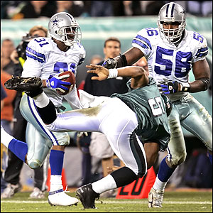
Relational Model
A database is a collection of related tables
NFL Database
Player
Team
Owner

Slide 7
Database Features
Set of tables
Explicit control over data (column) types in tables
Date | Site | Height | Count
<dates only> | <text only> | < real numbers only> | < integers only>
Notes:
Advantages: quality control and performance

Slide 8
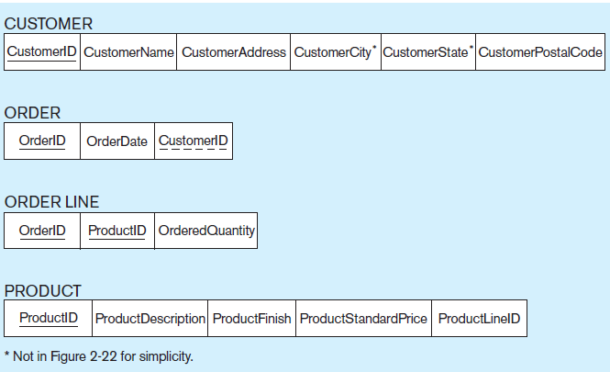
Database Design Example
Primary Key
Foreign Key
Date | Site | Species | Height | Diameter
 | A
 | B
 | A
 | C
Notes:
Allows on-the-fly min-n-matching of tables

Slide 9
Identify Data Needs
Data Modeling
Analyze data needs
Visualize the data objects
Questions to Ask
Why do you want to collect the data?
What do you want to do with it?
Who else will be using the data, what do they want from it?
Notes:
Let’s start designing a Database……
Before you define your database structure ask questions to determine what you will collect & how to organize it
Analyze & visualizing data…. Data Modeling
Questions to ask when determining your data needs…..

Slide 10
3 Steps to Database Design
Split Data Into Tables
Normalization
Each field must contain only one value
Each field must have a unique name
Determine Data Type for Each Column
Identify Relationships Between the Tables
No two records can be identical
Notes:
After you have identified your data and determined how that data might be divided into tables, you will need to optimize your data (called Normalization).
Purpose of using a database is to make things more efficient and easier to work.
Data types… text…. Number, date/time and how big (for storage size with variables)

Slide 11
Salesforce Labs
The Salesforce labs will walk you, step by step, through the database design (and app design) process.
Let's get started!

