Slide 1
BUS311: Website Development Lab Overview Prof. Kazman

Slide 2
WEBSITE DEVELOPMENT BASICS
The world
Web hosting site
Web browser
Web Server
URL
Web pages (HTML)
Web pages (HTML) &
Other linked files
<Direct Publishing>
File transfer SW
(Filezilla, SSH, …)
Web site development tools
Web publishing tools
Your computer

Slide 3
Web Browsers and Hosts
Popular Web Browsers:
Chrome
IE
Firefox
Safari
Website hosting:
ISP
Free Host (e.g. Google sites)
Domain Host (e.g. www.hawaii.edu)

Slide 4
Web-page/Site Development Tools
Text Editors: Notepad
HTML Editors: DreamWeaver, SeaMonkey (free; used for this class)
Graphics/image/animation: Photoshop, etc.
Programming:
Server-side: PHP, ASP
Client-side: Javascript
Database: Access, MySQL, etc.

Slide 5
WEBPAGE DEVELOPMENT (UH Host)
Your URL: http://www2.hawaii.edu/~username
The world
Hostname: uhunix.hawaii.edu Username: <Your UH Username> Password: <Your Password> Directory: public_html
Web browser
Web Server
Web pages (HTML)
!!! Your home page must be named index.htm (or index.html) !!!
FileZilla
<Direct Publishing>
Web site development tools
Web publishing tools: SeaMonkey
File transfer software: FileZilla
File Transfer
(upload/download)
Your computer
Important: UH does not support FTP, only SFTP

Slide 6
Money can buy….
Templates:
webflow.com
freewebsitetemplates.com
Entire web-sites (e.g. web.com, wix.com, weebly.com, squarespace.com, godaddy.com)
But you can’t use any of these for A2!

Slide 7
Website Design Rules
Rule 1. The website should offer something unique:
A good website is compelling; it provides value to your audience that draws them in again and again
Meets clearly identified business goals
The value proposition of the business should be clear, ideally on the home page
Utilizes the 7 “C”s of web capabilities: convenience, cost, coordination, collaboration, communication, customization, community
Notes:
Convenience, cost, coordination, collaboration, communication, commerce, community

Slide 8
Website Design Rules
Rule 2. The website must be aesthetically pleasing.
Rule 3. The website must be easy to use and fast.

Slide 9
Example

Slide 10
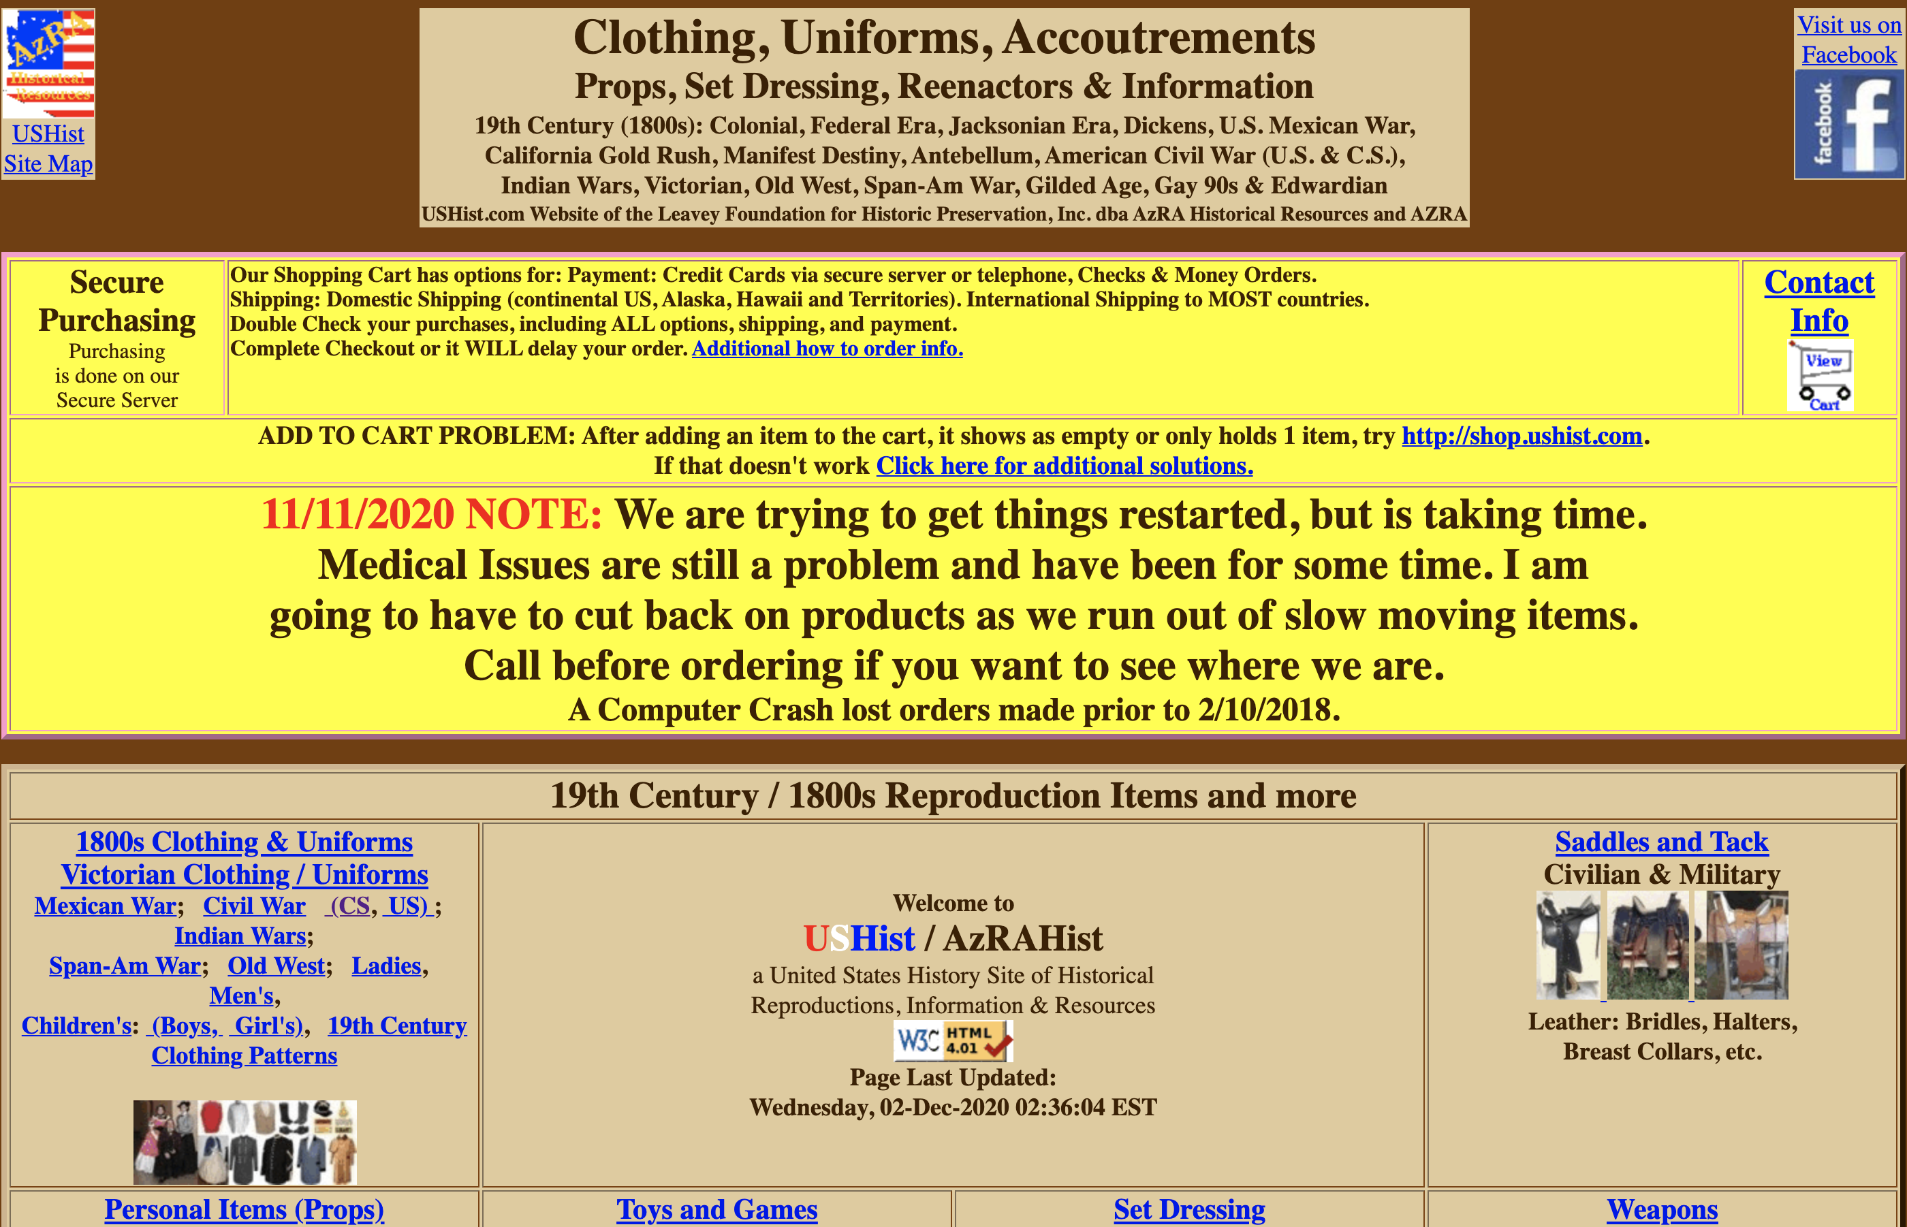
Negative Example

Slide 11
Website Design Rules
Rule 4. The website must motivate people to visit, to stay, to return.

Slide 12
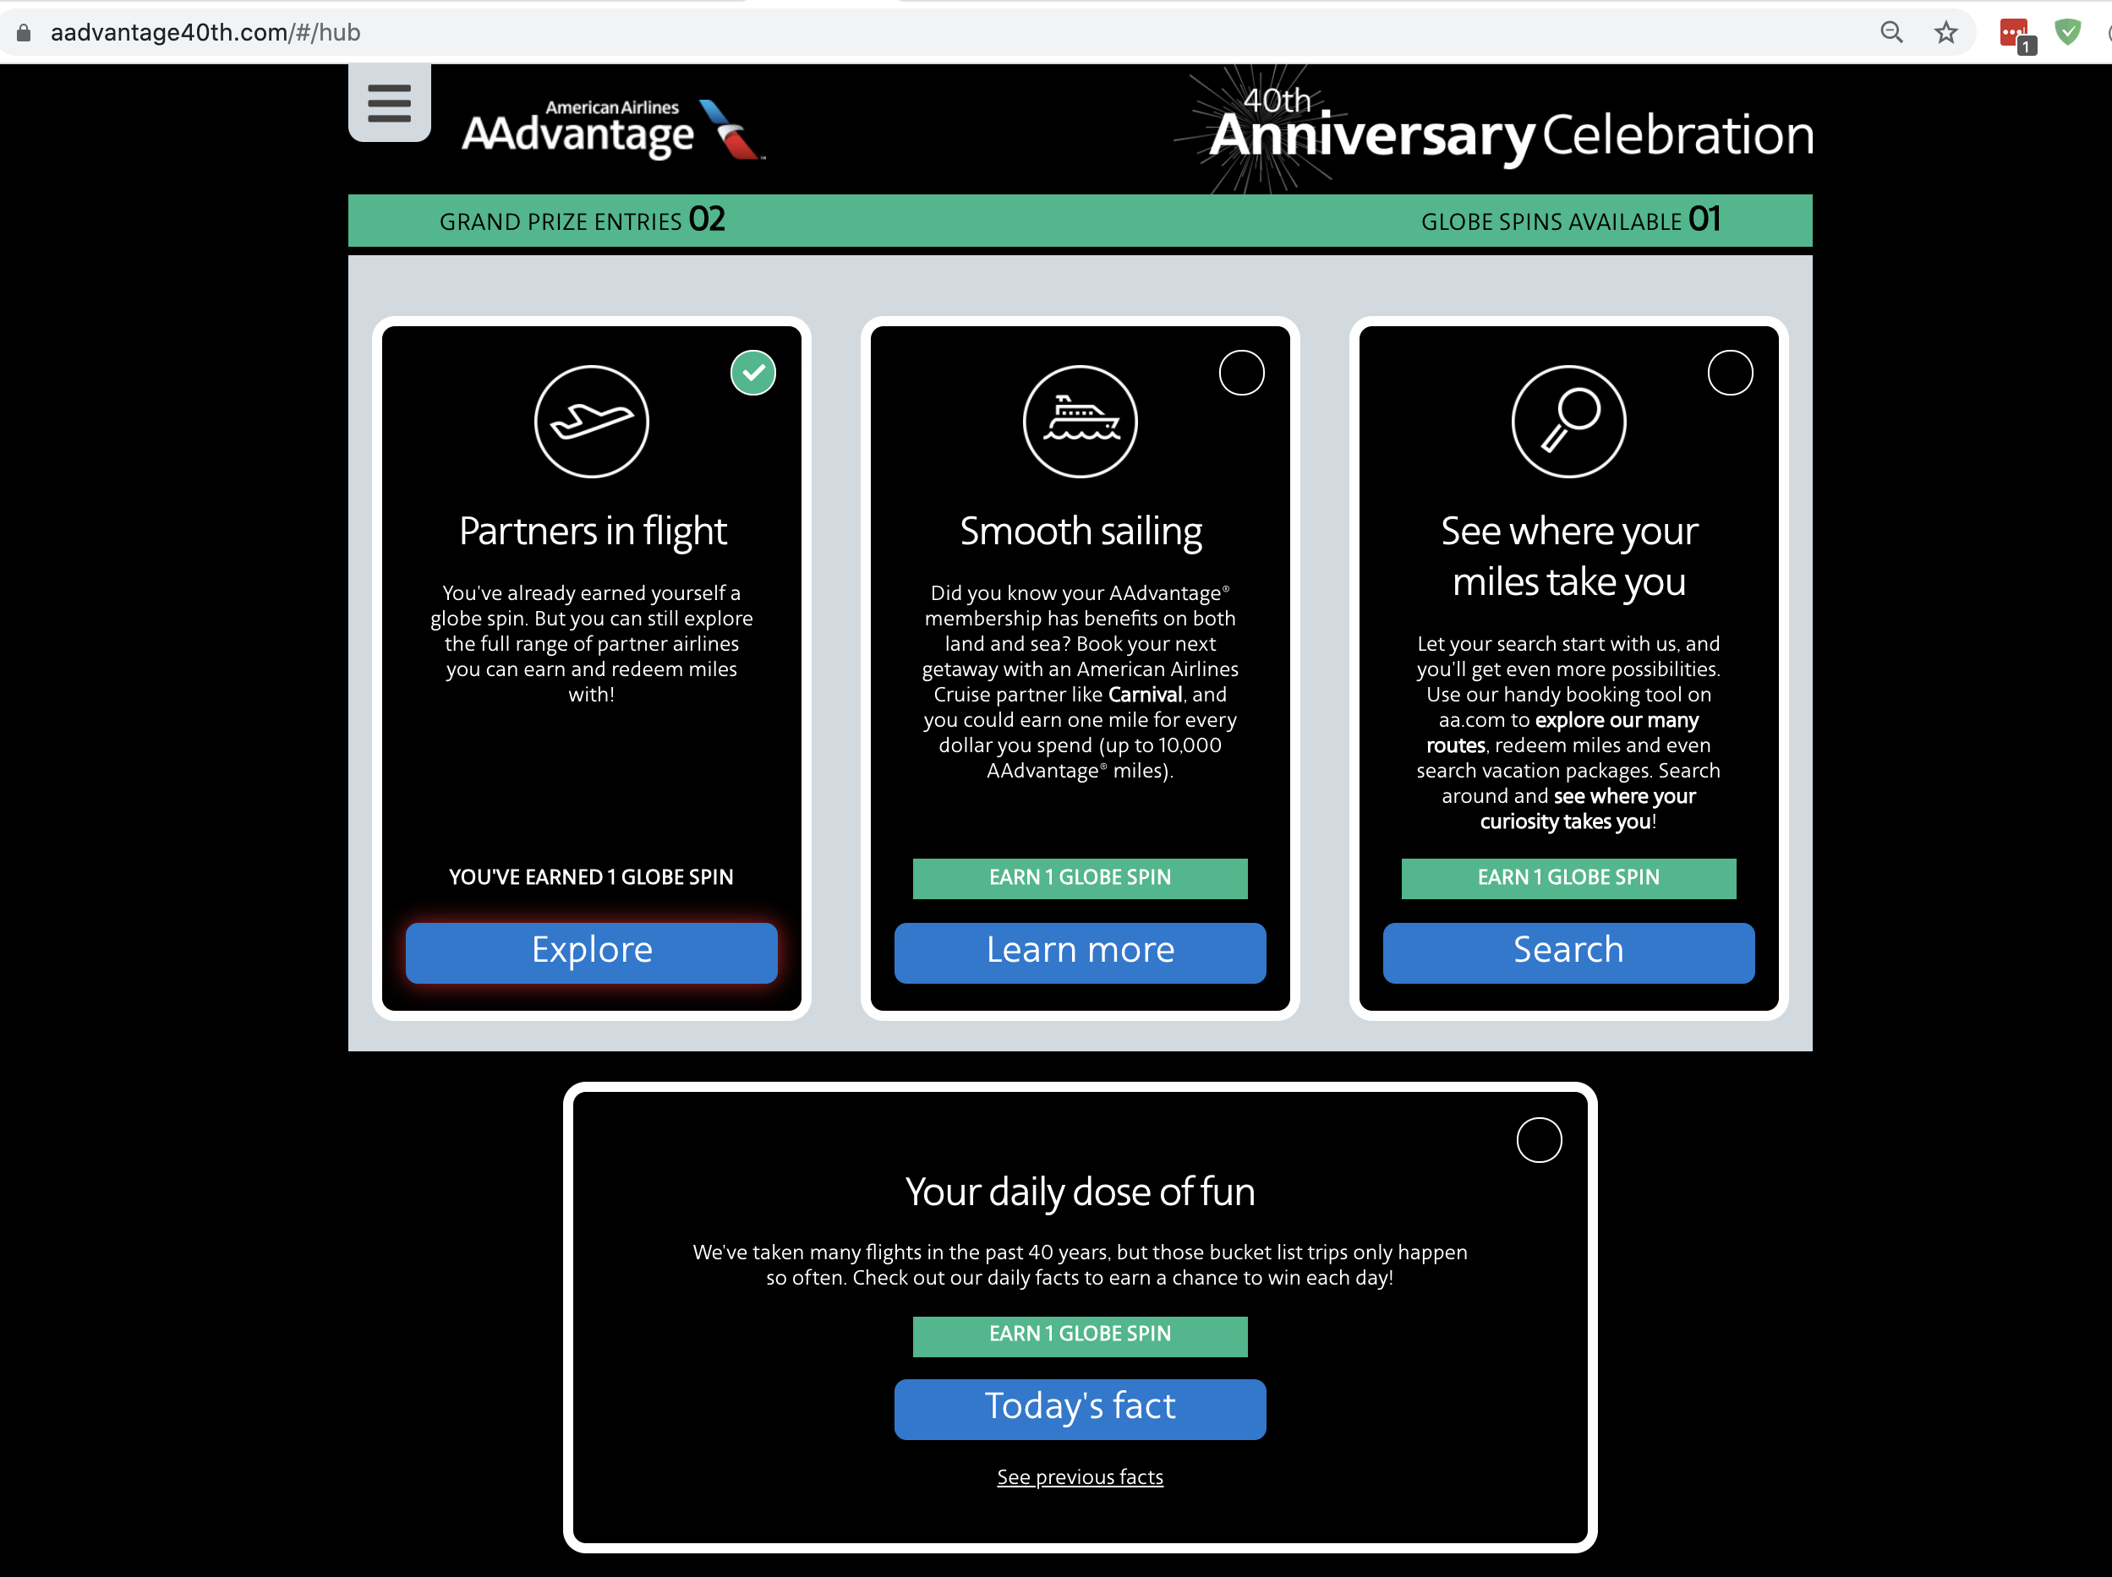
Example

Slide 13
Website Design Rules (3)
Rule 5. You must advertise your presence on the web.
Rule 6. You should learn from your website.

Slide 14
Planning Your Website
Identify the goals of your website
Identify your audience
Create a list of content that both achieve your goals and is of interest to your audience.
Divide this list into pages
Create a navigation scheme (site map) that links these pages together in a simple, consistent way

Slide 15
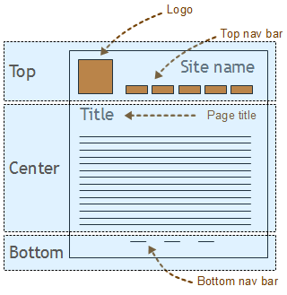
Planning Your Page Layout
Use tables to divide the page into regions
header
sidebar
footer
content

Slide 16
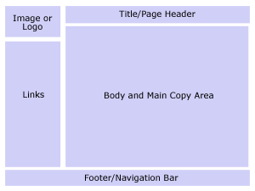
Planning Your Page Layout
Use tables to divide the page into regions
header
sidebar
footer
content

Slide 17
Planning Your Page Layout
Design each region
add text
add images
add links

Slide 18
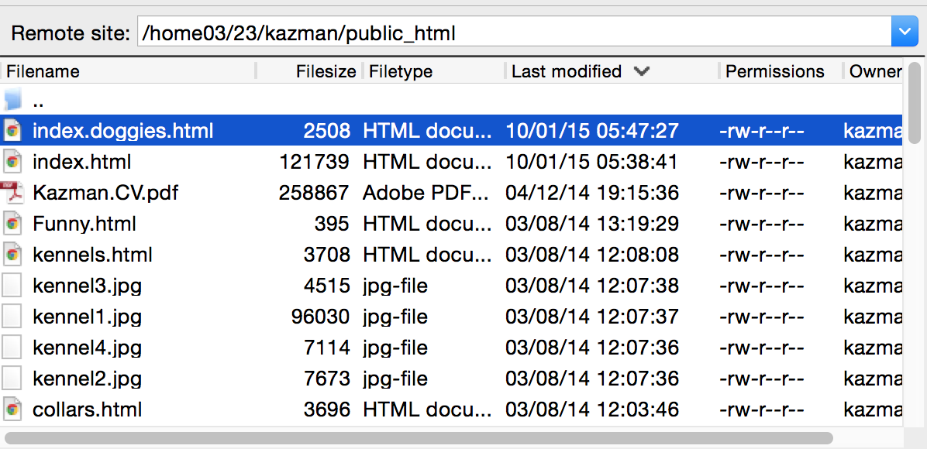
Final Words
Make sure that your UH home page works.
Try transferring a file and see if you can view it.
HINT: you may need to change the file permissions so that "everyone" can read the file.

