Slide 1
Skandha (5 Aggregates (C. 五蘊)
Notes:
This will be a very brief introduction to the Skandha, the Five Aggregates.

Slide 2
Review
Four Noble Truths (S. catvāry āryasatyāni; C. 四聖諦)
Truth of Suffering (S. Duḥkhasatya; C. 苦諦)
Truth of Origination of Suffering (S. Samudayasatya; C. 集諦)
Truth of Cessation of Suffering (S. Nirodhasatya; C. 滅諦)
Truth of the Path Leading to the Cessation of Suffering (S. Mārgasatya; C. 道諦)
Notes:
Just a bit of review: One of the main teachings of the Buddha was that of the Four Noble Truths.
The first is the Truth of Suffering.
The origination of suffering: The Buddha taught that suffering is caused by tanha. Literally thirst but translated as desire, greed, clinging.
The cessation of suffering. If we rid ourselves of desire, if we follow the teachings, we can reach a state of non-suffering, of nirvana.
And the Path leading to the cessation of suffering—called the Noble Eightfold Path.
[click] In examining the skandha we are probing deeper into the origination of suffering.
Four Noble Truths: Sì Shèng Dì
Truth of Suffering: Kǔ Dì
Truth of Origination of Suffering: Jí Dì
Truth of Cessation of Suffering: Miè Dì
Truth of the Path Leading to the Cessation of Suffering: Dào Dì

Slide 3
Anātman
Review
An
Ātman
Negative prefix
Self
We don’t exist?
Notes:
In order to understand the Skandha it also helps to understand the concept of Anātman, a major principle in Buddhism.
[click] Anātman consists of two parts: The first is “An” [click] a negative prefix.
[click] The second is “Atman” [click] meaning self. So put these together an you get a term that is sometimes translated as “no self.”
[click] Does this mean that Buddha said we don’t exist?
[click] No. In fact, Buddha rejected nihilism.

Slide 4
Anātman
Review
Hinduism
Buddhism
Ātman = Brahman
Anātman
There is no permanent, self-arising, unchanging, self
Permanent, unchanging, self of the individual
Permanent, unchanging, self nature of the universe
Notes:
The term Anatmpan represents a break with Hinduism.
[click] In Hinduism there is a concept of Atman being equal to, or more accurately, no different from, Brahman
[click] Atman in Hinduism refers to the permanent, unchanging self of the individual.
[click] Brahman, in this context, refers to the permanent, unchanging self-nature of the universe.
The one is equal to the other. The permanent, unchanging self of the individual is none other than the permanent, unchanging self-nature of the universe. Scholars sometimes refer to this as the macrocosm within the microcosm.
[click] In the teachings of the Buddha
[click] There is no permanent, self-arising, unchanging self.

Slide 5
A question…
Review
We don’t exist?
Anātman
There is no permanent, self-arising, unchanging, self
What is this entity that I call “me”?
Notes:
So…
[click] If Buddhism doesn’t say that we don’t exist,
[click] But it does say that there is no permanent, self-arising, unchanging self,
[click] What is this entity that I call “me”?

Slide 6
Dependent Arising
Review
“me”
Phenomenon
Phenomenon
Phenomenon
Phenomenon
Phenomenon
Constantly changing (impermanence)
Phenomenon
Phenomenon
Notes:
To explain that we need to bring in the concept of dependent arising.
When certain conditions are just right, a number of phenomena come together in just the right way to produce a human being.
What we call “me.”
The problem is that conditions are constantly changing, and these phenomena are constantly changing.
Which means that we are constantly changing as well, even when we are not conscious of those changes.

Slide 7
Impermanence
Review
“me”
Phenomenon
Phenomenon
Phenomenon
Phenomenon
Phenomenon
Phenomenon
Phenomenon
Notes:
Eventually, conditions are no longer right for these phenomena to form an entity, and they dissipate.
The individual ceases to exist.

Slide 8
5 Aggregates (S. Skandha ; C. 五蘊)
Self-Identity
"If Buddhism denies a permanent self, how does it perceive identity?… What we conventionally call a 'person' can be understood in terms of five aggregates, the sum of which must not be taken for a permanent entity, since beings are nothing but an amalgam of ever-changing phenomena.”
Thanissaro Bhikkhu. “The Five Aggregates: A Study Guide.” https://www.accesstoinsight.org/lib/study/khandha.html
Notes:
What about our personal identity? Most of us don’t think of ourselves as a bunch of phenomena that come together, are constantly changing, and eventually dissipate.
[click] That’s where the skandha come in. What we conventionally call a “person” can be understood in terms of the five skandha.

Slide 9
5 Aggregates (S. Skandha ; C. 五蘊)
These five aggregates are the building blocks that we typically use to construct our sense of personal identity; they are the things that we cling to as being “mine,” “I,” and “my self.” (Bhikkhu Bodhi. In the Buddha’s words, p. 22)
(Aggregates)
Notes:
Sakyamuni Buddha observed that there are a number of phenomena that we use to construct our sense of self, that we cling to as either the “me” or “mine.”
Buddha organized these phenomena into five categories. These categories are known as the Skandha.
Tradition says that the Buddha, when talking about these categories, would make piles of pebbles. These piles, these aggregates, are the origin of the term Skandha.

Slide 10
5 Aggregates (S. Skandha ; C. 五蘊)
Form or materiality (S. Rūpa; C. 色)
Sensations/feeling (S. Vedanā; C. 受)
Perception or discrimination (S. Saṃjñā; C. 想)
Mental formations/Volition/Volitional formations/Conditioning factors (S. Saṃskāra; C. 行)
Consciousness (S. Vijñāna; C. 識)
Notes:
So what are the five skandha?
[click] Form, sometimes translated as materiality.
[click] Sensation
[click] Perception
[click] Mental formations, also referred to as volitional formations.
[click] Consciousness.

Slide 11
5 Aggregates (S. Skandha ; C. 五蘊)
Form or materiality (S. Rūpa; C. 色)
Overall shape
Color
Flat surface
Texture
Fragrance
Notes:
Let’s start with Rupa, Form.
[click] Let’s say that you walk into a meeting and someone hands you a name card.
[click] The name card has physical attributes: it has an overall shape;
[click] it has a flat surface,
[click] it has color,
[click] it has texture (smooth or rough), and
[click] it may have fragrance.
These are inherent to the object, whether you see and touch it or not.
This is rupa, form.

Slide 12
5 Aggregates (S. Skandha ; C. 五蘊)
Form (S. Rūpa; C. 色)
The Physical Body
Notes:
How does the concept of Rupa, form, apply to us?
[click] What are these people doing?
They’re taking a “selfie.” We identify our physical bodies as ourselves. How many of us have looked at a photograph and said to ourselves, “Oh, look, that’s me! There I am!”
[click] Form, in terms of our perception of self, is the physical body.

Slide 13
5 Aggregates (S. Skandha ; C. 五蘊)
Sensations/feeling (S. Vedanā; C. 受)
You take your name card, sensing it through your fingers
Pleasant
Unpleasant
Neutral
Notes:
The second aggregate is sensation.
[click] Let’s return to our meeting. Let’s say that you reach out and take your name card. At that instant you sense it through your fingers.
[click] This sensation may be pleasant.
[click] It may be unpleasant (maybe it has a rough, gritty feel to it).
[click] Or it may be neutral.

Slide 14
5 Aggregates (S. Skandha ; C. 五蘊)
Perception or discrimination (S. Saṃjñā; C. 想)
Your brain now starts processing, seeking first to identify the shape, then name the object in accordance with past experiences
Notes:
The third aggregate is perception.
[click] After the initial sensation your brain starts processing the information it has received.
It identifies the shape of the object.
It sorts through pictures in the mind looking for something similar, then comes up with a name for the object being sensed.
The mind then attaches a label for what we see, which will color from this moment forward how we perceive and interact with the object.

Slide 15
5 Aggregates (S. Skandha ; C. 五蘊)
Mental formations/Volitional formations
(S. Saṃskāra; C. 行)
You decide what to do in response
Crumple it up and throw it down on the table? (You hate name cards)
Smile and thank the person who gave it to you?
Notes:
The fourth aggregate is mental formations also translated as volitional formations.
[click] You decide what to do in response to this sensation.
[click] Maybe you’re a non-conformist that hates name cards. And you’re having a really rotten day. So you decide to crumple up the name card and thrown it down on the table.
[click] Or maybe you choose to smile at the person who gave you the name card and thank them for setting up the meeting.

Slide 16
Sensory Contact (S. Sparśa, C. 觸)
Consciousness (S. Vijñāna; C. 識)
6 Internal Sense Bases
6 External Sense Bases
6 Sensory Consciousnesses
Eye
+
Visible Object
Eye Consciousness
=
Sensory Contact
Ear
+
Sound
Ear Consciousness
=
Sensory Contact
Nose
+
Odor
Nose Consciousness
=
Sensory Contact
Tongue
+
Taste
Tongue Consciousness
=
Sensory Contact
Body
+
Touch
Body Consciousness
=
Sensory Contact
Mind
+
Mental Object
Mental Consciousness
=
Sensory Contact
Notes:
The fifth aggregate is consciousness. Buddhism describes many consciousnesses.
[click] For example,
When the eye (an internal sense base, in ordinary parlance we would call this a sense organ) senses a visible object (an external sense base) this results in eye consciousness, and this entire process is referred to as sensory contact, sparśa. [click]
This is true for the ear, nose, tongue, body, and mind, as well.
Notice that Buddhism considers the mind as a sense base.
So there are six sensory consciousnesses.

Slide 17
5 Aggregates (S. Skandha ; C. 五蘊)
Consciousness (S. Vijñāna; C. 識)
Consequences
Ālaya Vijñāna
Crumple it up and throw it down on the table? (You hate name cards)
Negative seed
Positive seed
Positive seed
Negative seed
Negative seed
Positive seed
Negative seed
Positive seed
Smile and thank the person who gave it to you?
Positive seed
Positive seed
Notes:
There’s another consciousness we should mention.
[click] This consequence explains why everything we think, say, or do can produce consequences.
[click] Say that you decide to crumple the name card up and throw it onto the table.
[click] That thought, and even more so if you act on that thought, produces a negative karmic seed.
[click] That negative karmic seed then gets embedded in the Alaya Vijnana, the Storehouse Consciousness.
[click] If, instead, you decide to smile and thank the person who gave you the name card, that produces a positive karmic seed.
[click] That positive karmic seed is stored in the Alaya Vijnana.
[click] Over time, many karmic seeds accumulate in the Alaya Vijnana. When we die and are reborn, this Storehouse Consciousness goes with us. The result is that at sometime in the future, each of these karmic seeds, whether positive or negative, will ripen. Negative seeds produce negative future experiences, suffering. Positive seeds produce positive future experiences.
This is how karma works.

Slide 18
5 Aggregates (S. Skandha ; C. 五蘊)
Two errors we make concerning the Skandha
Falsely identify as “Me”
Falsely identify as “Mine”
Brilliant Idea
That’s stupid!
Mental formations/Volitional formations
(S. Saṃskāra; C. 行)
How do you feel?
You
Why?
Boss
Notes:
There are two errors we make concerning the Skandha:
[click] Identification: We falsely identify them as “me.”
[click] Possession: We falsely identify them as “mine.”
Let’s take mental formations as our example.
[click] Let’s say you are at a meeting at work.
[click] You express what you think is a brilliant idea.
[click] Your boss, however, says, in front of everyone: “That’s incredibly stupid. That’s the most stupid thing I’ve heard all day.”
[click] How do you feel?
[click] If you’re like most of us, this does not make you feel good.
[click] The question is: why?
[click] We see our thoughts, our expressions, [click] as extensions of the self.
If someone attacks our ideas, our expressions we feel it as an attack on the self.
That false identification as the self leads to suffering.

Slide 19
5 Aggregates (S. Skandha ; C. 五蘊)
Two errors we make concerning the Skandha
Falsely identify as “Me”
Falsely identify as “Mine”
Form
(S. Rūpa; C. 色)
Suffering
The Physical Body
Reactions:
1) Physical pain
2) Emotional pain
Notes:
Let’s look at Rupa, form.
[click] We identify the body as “me.”
[click] What happens when we the body is injured? Let’s say you put a serious gash in your arm and it’s bleeding.
[click] Let’s take a look at our reactions to such an event.
[click] First, we experience physical pain. The body has a system by which it alerts us that the physical stability—the healthy equilibrium of the body—has been thrown off; we are injured and we must attend to this.
[click] But there is a second reaction that occurs almost instantaneously after the first. We feel emotional pain, in this case probably fear. Because we identify the body as the self an injury to the body is experienced as an existential threat.
[click] And so we experience suffering.

Slide 20
5 Aggregates (S. Skandha ; C. 五蘊)
Two errors we make concerning the Skandha
Falsely identify as “Me”
Falsely identify as “Mine”
Form
(S. Rūpa; C. 色)
Suffering
The Physical Body
Old Age
1) Physical pain
2) Emotional pain
Notes:
It’s not just injury that brings suffering.
[click] There is also aging. We may once have been young and healthy but now we look in the mirror and we this shriveled up body with thinning hair and poor eyesight.
[click] Aging brings physical pains.
[click] And, because we identify the body with our “self,” we experience emotional pains.
[click] We experience suffering.

Slide 21
5 Aggregates (S. Skandha ; C. 五蘊)
Two errors we make concerning the Skandha
Falsely identify as “Me”
Falsely identify as “Mine”
Cure
Mindfulness
Meditation
Objectively observe thoughts arise, change, and disappear without identifying with them
Notes:
I don’t want to leave you without some hope of eliminating suffering. So let’s just mention one of the techniques for curing this affliction of clinging to the skandha.
What is a cure for the suffering caused by false identification of the skandha as ourselves?
[click] Cure is mindfulness, which we can develop through mindfulness meditation.
[click] In mindfulness meditation we learn to objectively observe our thoughts arise, change, and disappear without identifying with them.
This can be done while observing the breath. Watching each breath rise and fall. When a thought arises we simply observe it, watch how it changes, and watch it disappear.

Slide 22
5 Aggregates (S. Skandha ; C. 五蘊)
Freedom
Freedom “without feature or surface, without end, luminous all around”
Thanissaro Bhikkhu. “The Five Aggregates: A Study Guide.” https://www.accesstoinsight.org/lib/study/khandha.html
Notes:
So, what does one experience when one lets go of one’s clinging to the skandhas?
Freedom.

Slide 23
May all sentient beings be free of suffering
Notes:
This has been a very brief introduction to the Skandha, the Five Aggregates.

Slide 24
5 Aggregates (S. Skandha ; C. 五蘊)
Seeking a Cure
Taking each khandha in turn, [The Buddha] asked: “Is it constant or inconstant?” Inconstant. “And is what is inconstant stressful or pleasurable?” Stressful. “And is it fitting to regard what is inconstant, stressful, subject to change as: ‘This is mine. This is my self. This is what I am’?” No.
Thanissaro Bhikkhu. “The Five Aggregates: A Study Guide.” https://www.accesstoinsight.org/lib/study/khandha.html
Notes:
So, if clinging to the skandhas is a source of suffering, how do we find release from suffering?
By letting go.

Slide 25
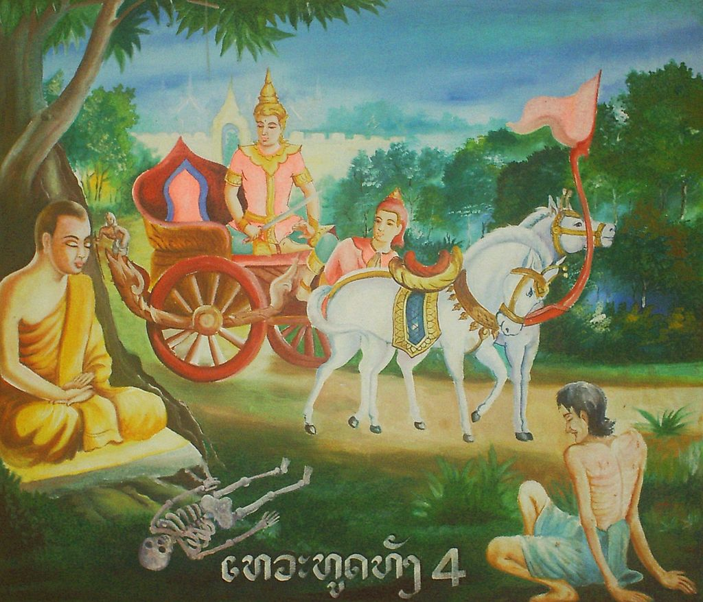
5 Aggregates (S. Skandha ; C. 五蘊)
Four Sights That Motivated Prince Siddhartha to Undertake a Spiritual Path
Suffering
Old Age
Sickness
Death
By User:Sacca - Picture of a painting in a Laotian Temple, Public Domain, https://commons.wikimedia.org/w/index.php?curid=800455
Sage
Notes:
[click] Do you remember the four sights that Motivated Prince Siddhartha, who up until then had lived a life of pleasure in the palace of his father, the king, to undertake the spiritual path?
[click] An old man. A sick person. A corpse on the way to a funeral pyre.
[click] He saw evidence of suffering.
[click] But he also saw a sage, sitting in a state of equanimity.
This motivated Prince Siddhartha to leave home and follow a spiritual path. The path he took eventually led to enlightenment. And through this enlightenment the Buddha, the Awakened One, came to understand the origin of suffering, he came to understand the role of the skandha in causing suffering.

